Slide 1
Dynamic programming in assembly line
Comparison between brute force and DP approach
Lo Luca
S4121569

Slide 2
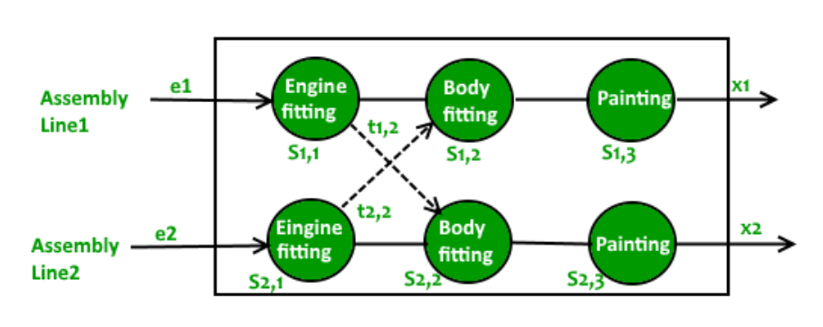
About the problem
We want to compute the fastest route

Slide 3
About the problem - parameters
2 assembly line each with n station (S_i,j, the i-th assembly line and j-th station)
a_i,j time taken by the station j-th at line i-th
t_i,j time taken to go from station i-th in line x to station j-th in line y where i<j and x != y
e_i entry time for any assembly line
x_i exit time for any assembly line
goes from S_i,j-1 to S_i,j is immediate

Slide 4
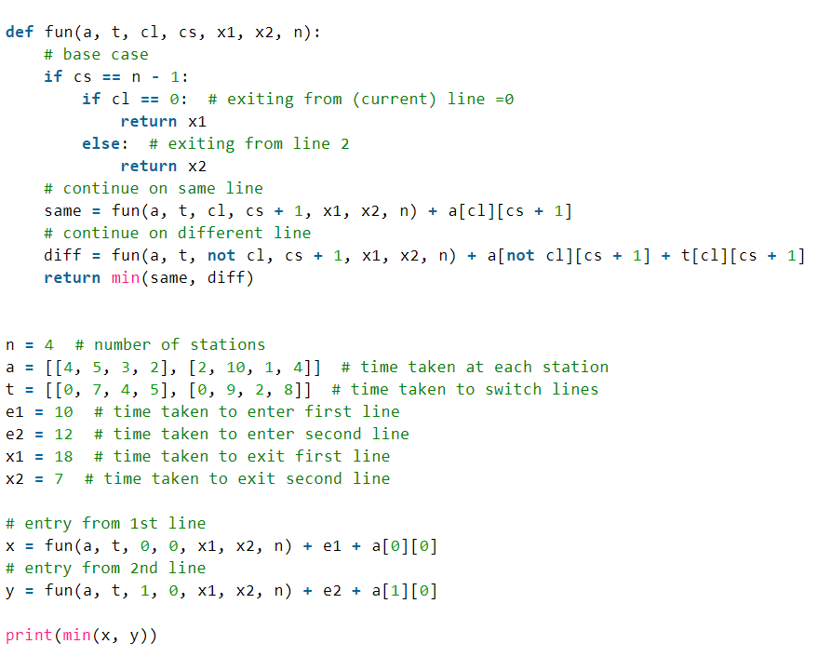
A brute force approach

Slide 5
A brute force approach
This method uses a recursive function to visit any possible solution, combination, path, and then check for the path with the minimum costs and return it.
Because we have 2 assembly line, we call the function 2 time. The function starts at the first station and at each station it consider if we want to continue in the same line or to change line. The function will recursively do the same decision for each node till the last node.
So at first we have 2 nodes. At second step we generate more 2 nodes for each node, so 2*2=4. At third step we generate more 2 nodes for our current nodes so 2*2*2=8 so our time complexity is O(2^n), where n represents the number of station in our single assembly line. Because we call the recursive function n times, the auxiliary space is O(n).

Slide 6
A brute force approach: downside
Let’s consider just the recursive tree when we call our recursive function for the assembly line 1. Remember S_i,j where i is the assembly line and j is the station in the assembly line
S_1,1
S_1,2
S_2,2
S_1,3
S_2,3
S_1,3
S_2,3

Slide 7
A brute force approach: downside
As you can see a problem is that we compute the value of S_1,3 and S_2,3 twice. But here we are consider only 1 recursive call for the assembly line 1. But if we consider also the assembly line 2, we also compute S_1,2 and S_2,1 twice and S_1,3 and S_2,3 thrice. If the number of station were higher, we would exponentially compute the same value over and over again.
Not to mention the auxiliary memory with each call of our recursive function that grows linearly with the length of our assembly line.

Slide 8
Dynamic Programming
Dynamic programming comes to solve those problems. The idea behind it, it’s to store somewhere, the computed value, and when needed, instead of computing it again, it is already available. So in term of graph/tree, instead of visiting each leaf node, we only visit a part of it.
Not only that. This approach breaks down the problem into smaller subproblems and compute its optimal solution for each of our subproblems

Slide 9
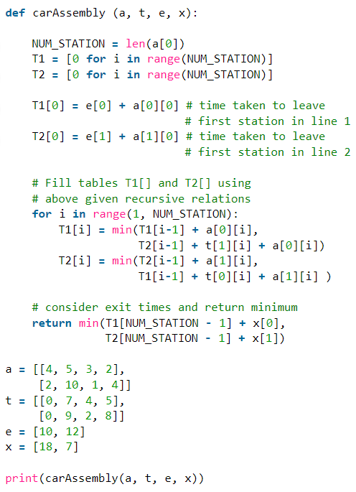
Dynamic Programming

Slide 10
Dynamic Programming
As you can see at each step we compute the optimal solution at each station given by comparing if it’s better if i came from the station from the current assembly line or it would have been better if i came from the other assembly line and then it stores the value in an array where we can access it instead of computing at each loop
In this way the time complexity goes down to O(n) where n is the number of stations in assembly line
And because we don’t have anymore the recursive calls, but just a function, the auxiliary memory is just O(1)

Slide 11
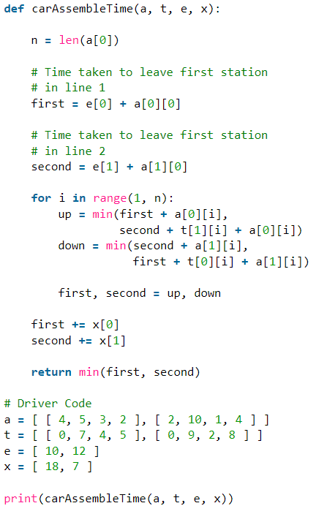
Dynamic Programming: further improvement

Slide 12
Dynamic Programming: further improvement
We notice that instead of saving up each step, we can just store everything in two variables instead of two arrays
The time complexity is still O(n)
The auxiliary memory is still O(1)

